Slide 1




Simulation and Predictive Modeling for Amusement Parks
Anas Alzahrani
Mohammed Al Othimeen
8 – 8 – 2021

Slide 2


Outline
The Qiddiya Theme Park
Project Scope and Goal
Simulation and Predictive Models
Performance Results
Insights
Conclusion

Slide 3

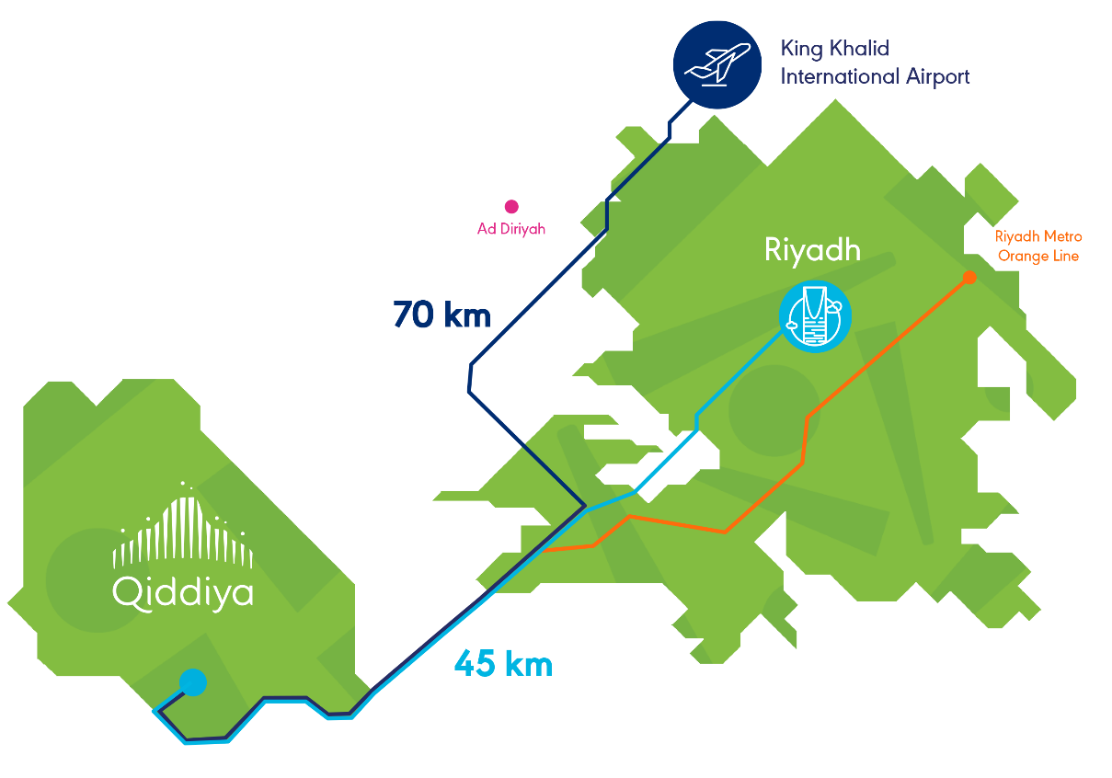




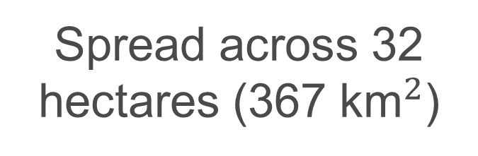
The Qiddiya
Theme Park
A location
where families spend quality time together and create memorable moments to treasure for life
The Kingdom's first of its kind theme park
Spread across 32 hectares (367 ${\text{km}}^{2}$)
Over 30 rides and attractions
6 themed lands
Note: Qiddiya is currently in its design and construction phase
Notes:
Qiddiya is a town that is located south of Riyadh,
Qiddiya’s 367km2 site sits on the doorstep of Riyadh.

Slide 4


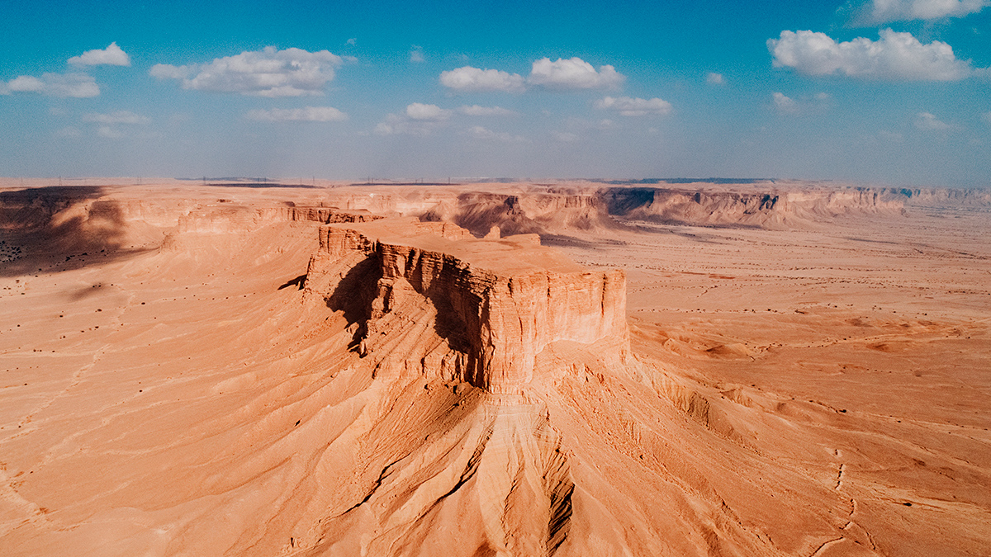
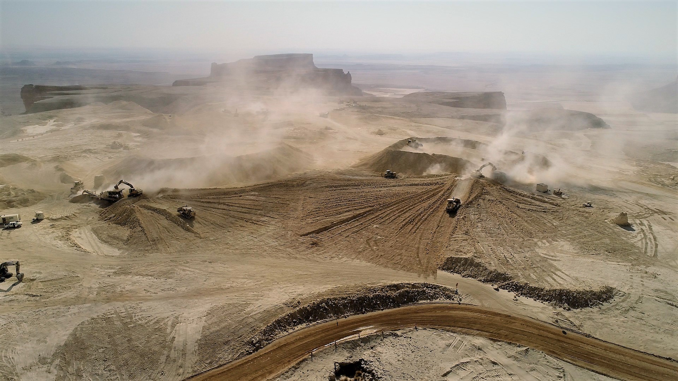
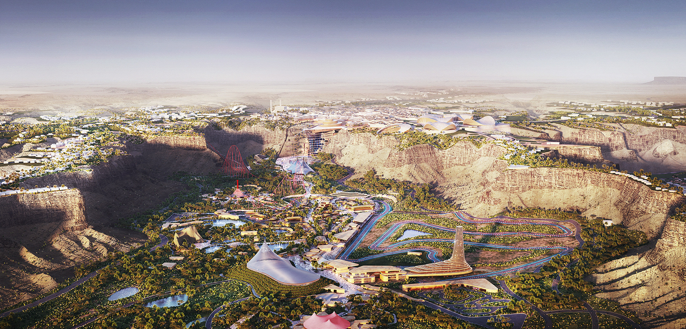



Transformation
2017
Currently
2030
Tourism as a new industry
No dependency on Oil
Economic diversity
Notes:
Saudi Arabia is moving towards a new economy that is based on services (i.e. service based economy).
Tourism is a major component in any service-based economy.
The Qiddiya project is going to be one of the major tourist destinations in Saudi Arabia.

Slide 5



Project Scope and Goal
Physical Infrastructure
IT Infrastructure
Business Case
Smart bracelet uses:
Radio Frequency Identification (RFID) technologies
Used for tracking and capturing data
Improve quality of service for visitor
Increase utilization of rides
Collect data about existing services and for future services
Ease decision making
3
Lands
9
Attractions
Smart Phone Application:
Online ticket
Physical map
Expected wait time
View data and statistics
Goal:
Simulate operations in the Qiddiya amusement park.
Notes:
The physical structure of Qiddiya will contain 3 lands and 9 attractions. Two elements of the expected IT infrastructure are relevant to our project, which are the smart bracelet and the smartphone application. The bracelet is used for tracking the visitors and capturing data. One important functionality of the smartphone application is to show the expected delays at the different rides.
We would like to propose the use of the smart bracelet and the mobile application in the Qiddiya theme park

Slide 6
Model Description
Higher level queuing system is applied to give a brief idea about the theme park queuing system operation.
A1.1
L1
A1.2
A1.3
A2.1
L2
A2.2
Departure
L2
Entrance
Sec.Check
A2.3
A3.1
L3
A3.2
A3.3

Slide 7
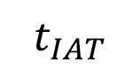
Event Graph
EL1=True
DL1
Visited_all_atts_L1 ==True
EQA11
EL1
EQA1#
(q_length_a12} >= AC12)
& (server_busy_a12) == False
(q_length_a12 >= AC12)
& (server_busy_a12) == False
(q_length_a12 >= AC12)
& (server_busy_a12) == False
Rej
EQA12
SA12
DA12
{cust_in_L1} += 1
ST12
$$t_{IAT}$$
(Time Til Close < 120 min)
{q_length_a12} += 1
{q_length_a12} -= AC12
{server_busy_a12} = True
{server_busy_a12} = False
Start Sim.
TPA
EL#
EL2
EQA13
Sec.S
Sec.E
{cust_in_TP} += 1
{cust_in_L2} += 1
EQA12=True
EL3
Note:
{cust_in_L3} += 1
The visit cycle applied in L1 will also be the same for L2 and L3. Then, TPD (Theme Park Departure) is visited.
Theme Park Departure (TPD) is prohibited until the customer visited all lands and attractions.
Visited_all_lands == True
TPD

Slide 8
Machine Learning
Machine learning will be used to predict the Customers’ waiting times at attractions.
Machine learning models that can be used for predicting the wait time are:
Regression Model
Neural Network Model
Random Forest Model
Simple to implement
Relatively fast to train
All training data must be supplied at once
Linear model
NN can be updated with new training data while retaining previous data
Non-linear model
Very accurate relative to other models
Long training time
Have hidden layers with incoherent features
Understandable features
Non-linear model
Classification model in nature
Can not extrapolate data
We have chosen Neural Network Model for its ability to be updated with new training data while retaining previous model.

Slide 9
Predictive Models
Neural Network :
Training Input features
x1
For Land Time Predictor:
1- Arrival time in minutes x1
2- Customers in land at time of Entry x2
3- Total time spent in Land, in minutes y1
Goal:
Predict total time spent in Land, in minutes
For Attraction Wait Time Predictor :
1- Arrival time in minutes x1
2- Service time of Attraction in seconds x2
3- Attraction Capacity x3
4- Waiting time in minutes y1
Goal:
Predict waiting time in minutes
LTP
x2
y1
x1
x2
AWT
x3
y1

Slide 10
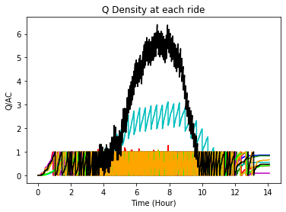
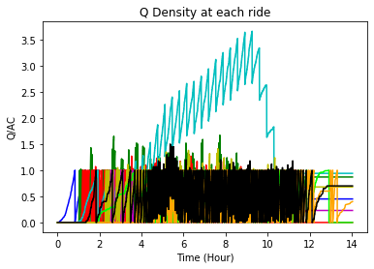
Performance Results
To have a good dataset, we made (n=5) runs and train our initial ML model on these runs
Legend:
b -> A11
g -> A12
r -> A13
c -> A21
m -> A22
y -> A23
lime -> A31
o -> A32
k -> A33
Random Land and Attraction choice Queue Densities combined
Utilizing ML for choosing Lands and Attractions
As apparent from the graphs above, we see that the maximum queue density reached 6 in the random simulation model, whereas it had reduced to approximately 3.5.

Slide 11
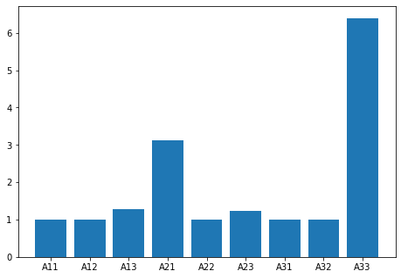
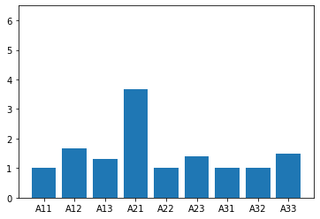
Performance Results
To have a good dataset, we made (n=5) runs and train our initial ML model on these runs
Average arrivals generated in one simulation run for the random choice model is
4,250 Arrivals
Average total data fed to the Machine learning model is
22,000 Arrivals
Avg = 1.9
Avg = 1.5
Maximum Queue Density for each Attraction, random model
Maximum Queue Density for each Attraction, NN model
As apparent from the graphs above, we see that the average queue density is 1.9 in the random simulation model, compared to an average of 1.5 in the neural network choice model.

Slide 12
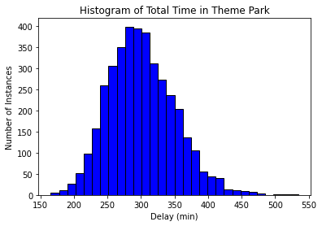
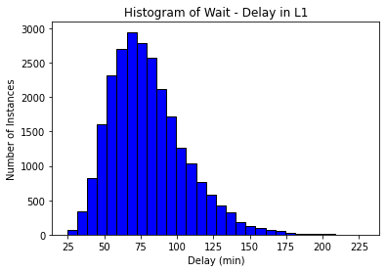
Insights:
The simulation run gives a brief understanding of how visitors behave inside an amusement park
The simulation runs have shown interesting results, namely the queue piling on attraction 33
Utilizing the predictor models to determine the lands and attractions has uniformly distributed visitors around the amusement park
Utilizing the predictor models has reduced the queue density inside the theme park attractions

Slide 13
Conclusion
We constructed a simulation model and predictive models to study the impact of the introduction of two technologies into the operation of the Qiddiya amusement park.
Smart bracelet
Mobile application
We have successfully shown that the quality of service and utilization of services can be improved using predictive model, which resulted in:
Even distribution of visitors
Less crowded sites
Implementing the two technologies above will assist in the generation of a historical database of visitor behavior

Slide 14
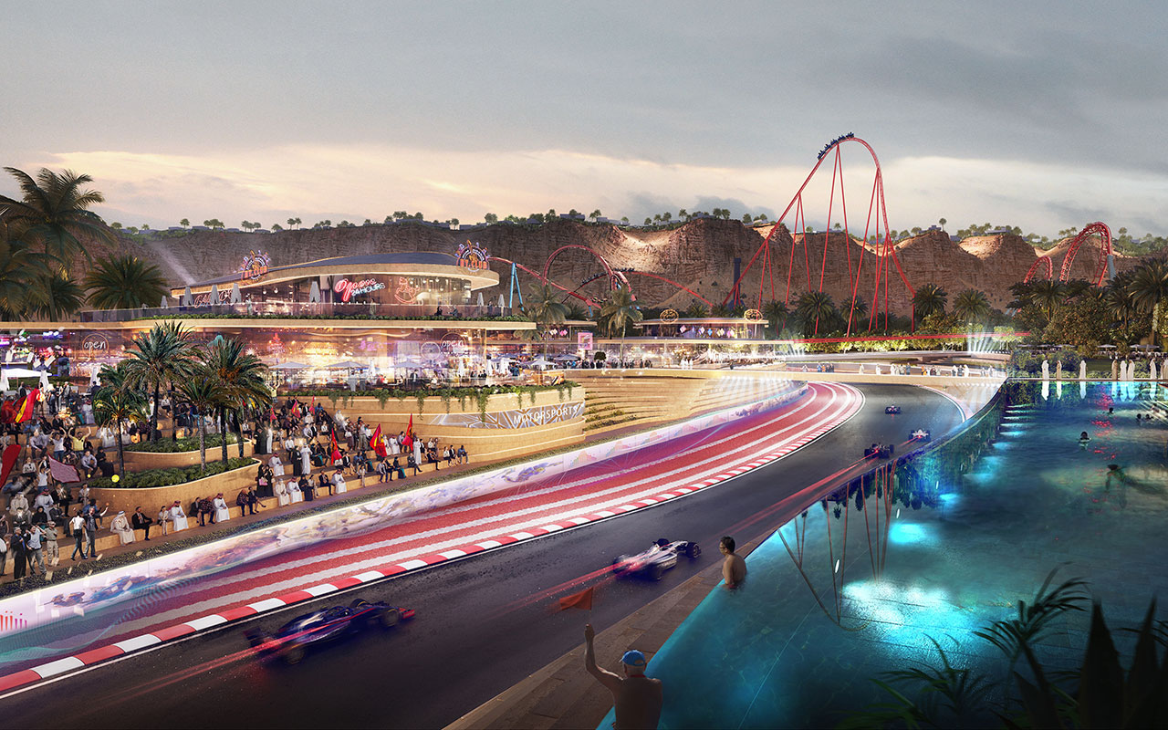

Slide 15
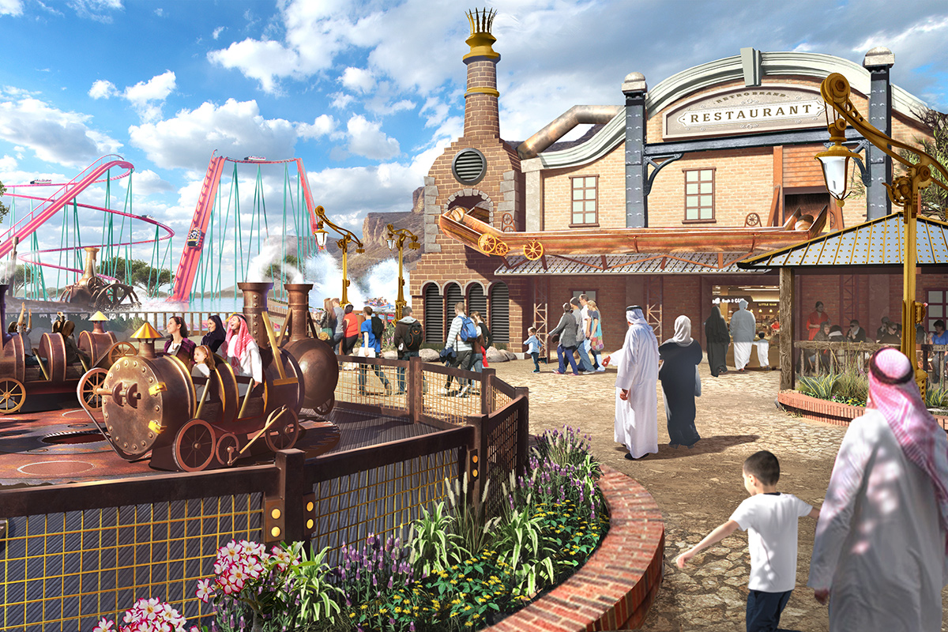

Slide 16
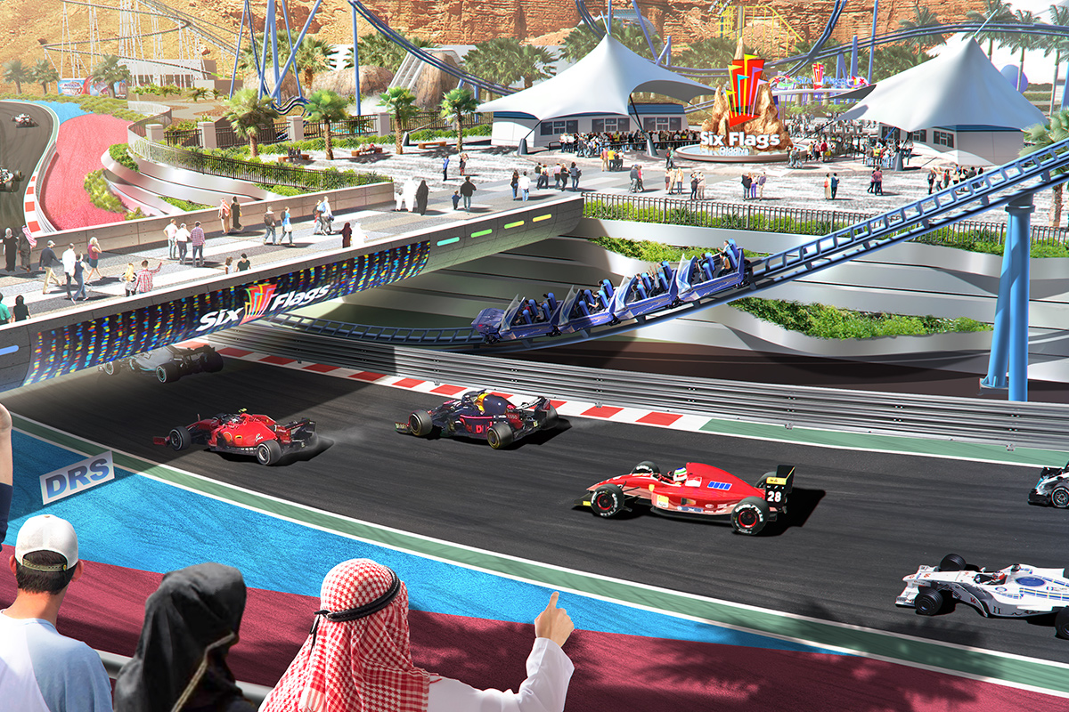

Slide 17

Thank you
8 – 8 – 2021

